Slide 1
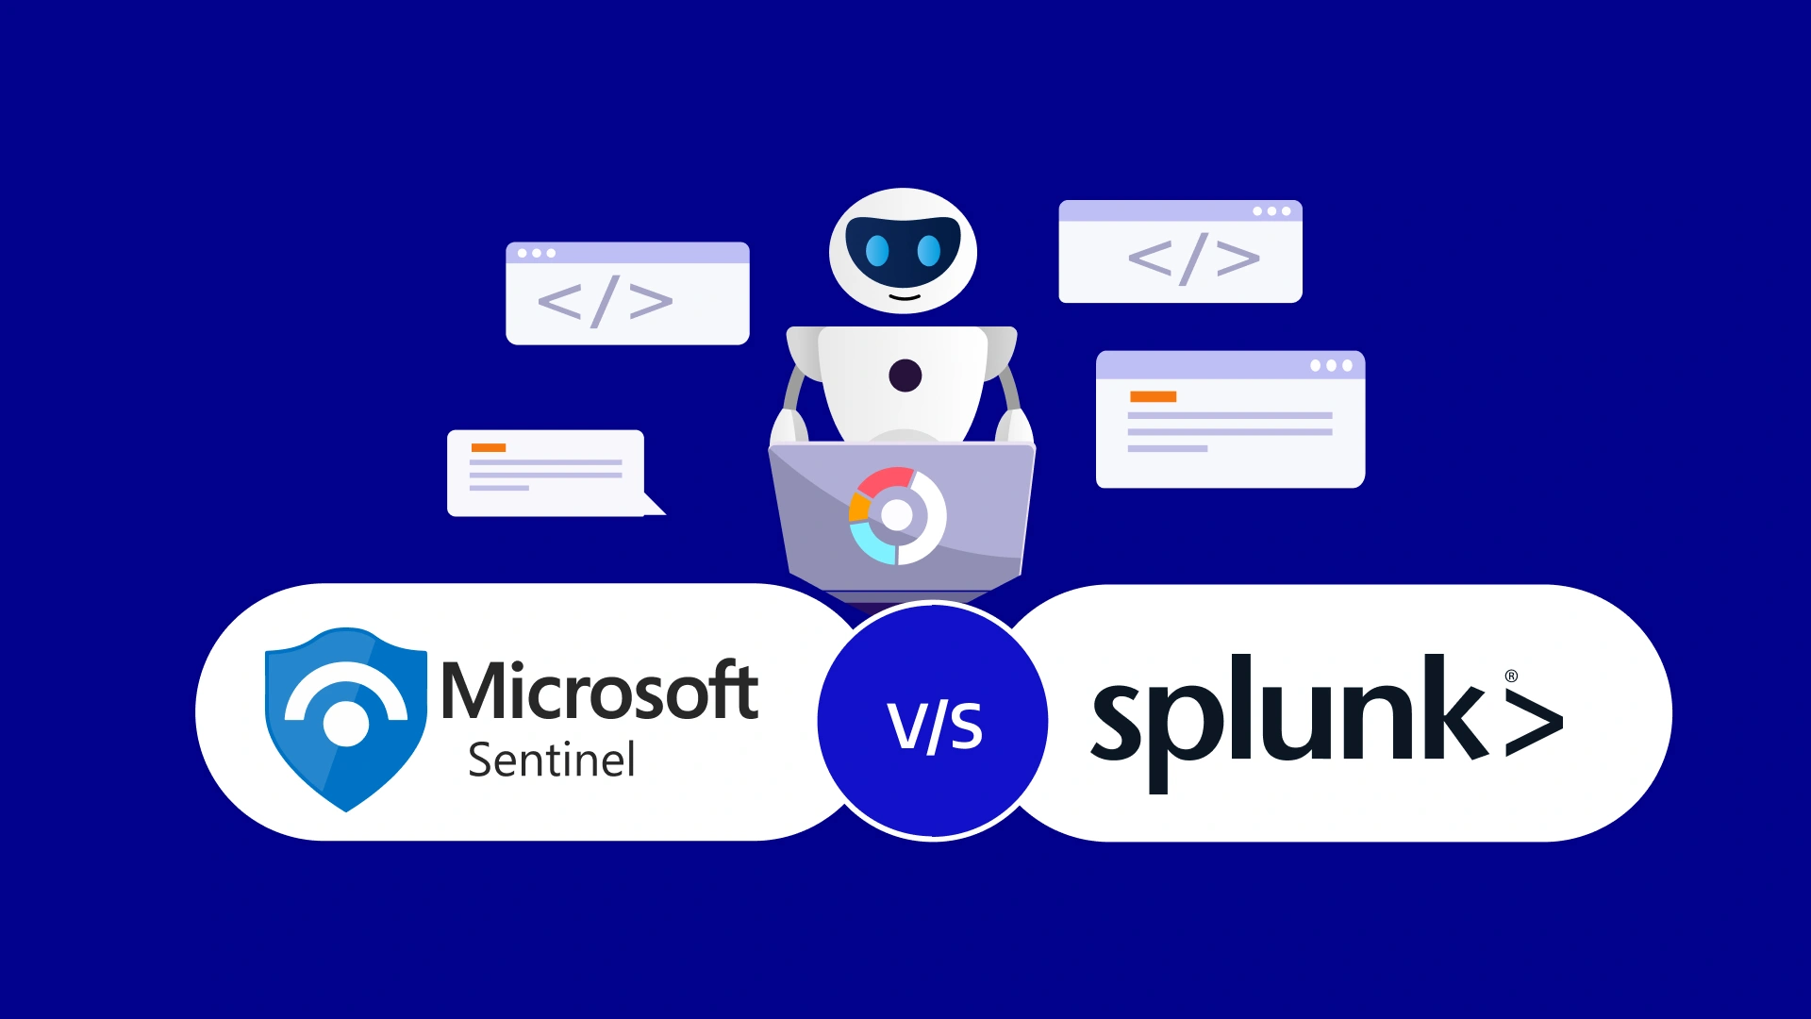
Case Study:
By: Jason Man
By: Jason Man
A Full Query Driven Investigation

Slide 2
Case Study: A Full Query-Driven Investigation
1
How Splunk and Microsoft Sentinel build one investigation from different data sources
The investigation progresses by turning each confirmed finding into the next focused query
1
Splunk Search
2
Investigation Pivot
3
Sentinel Query
Authentication logs
Compromised account
Broader cloud data
Analyst confirms suspicious login from unusual location
Asks: Where else it appeared, what other systems were affected?
Find additional compromised systems
Key Takeaway:
The investigation becomes stronger when each platform answers the next question using the data it covers

Slide 3
Step 1: The Splunk Search
2
Using authentication logs to confirm the initial signal
Splunk answers: Does the authentication evidence support the concern that the account is compromised?
Authentication logs
Relevant Source
Meaningful Finding
Authentication logs directly address the account-access question
The account logged in from an unusual location
Account activity
Unusual location
Why This Matters
The search provides the initial confirmation needed to justify deeper investigation
It does not need to answer the entire incident by itself but shows evidence for a compromised account
Confirmed concern
Key Takeaway:
Splunk establishes a supported starting point for the next investigative query

Slide 4
Step 2: The Sentinel Query
3
Following the compromised account across broader cloud-service data
The analyst pivots on the same account and asks a new question: What other systems did this account access?
Cloud Service
Data
Additional
Systems
Compromised
Account
KQL Query
Expanded
Scope
Key Takeaway:
Sentinel extends the investigation because its broader data coverage can reveal activity the first search did not include

Slide 5
How Query-Driven Investigation Works
4
Each answer creates the context for the next question
The platforms are connected by the investigation logic.
1 Ask
2 Confirm
Was the login suspicious?
Splunk confirms unusual authentication
4 Expand
3 Pivot
Sentinel surfaces additional systems
Where else did the account appear?
Key Takeaway:
A query is most useful when it is tied to a specific investigative question and informed by the evidence already confirmed

Slide 6
The Outcome: Properly Scoping the Incident
5
Different visibility combines into a more complete incident picture
Neither result is discarded; the analyst combines what each platform contributes to define the response scope.
Splunk Visibility
Sentinel Visibility
Confirmed unusual authentication
for the compromised account
Surfaced additional systems through
broader cloud-service data
Combined Scope
for Incident Response
Key Takeaway:
Using the right source for each question produced a fuller scope than either search alone

Slide 7
Key Lessons from the Case
6
A repeatable approach to cross-platform investigation
Start With Evidence
1
Use the platform and log source closest to the original alert to confirm whether the activity is meaningful
Pivot With Context
2
Carry confirmed evidence into the next query rather than starting over
Combine Coverage
3
Use different platforms when their data coverage answers different parts of the same investigation
Confirm
Pivot
Expand
Full Scope

